Slide 1

RISC-V SoC for Computer Vision Applications
Tutorial 4: Custom Core from HDL with APB Bus Interface
EE 297
Thursday, January 21, 2021
Project Members:
Anee Mineshkumar Dubhia^{[1]}
Chee Vang^{[2]}
Advisor:
Professor Harry Li, Ph. D.^{[3]}

Slide 2
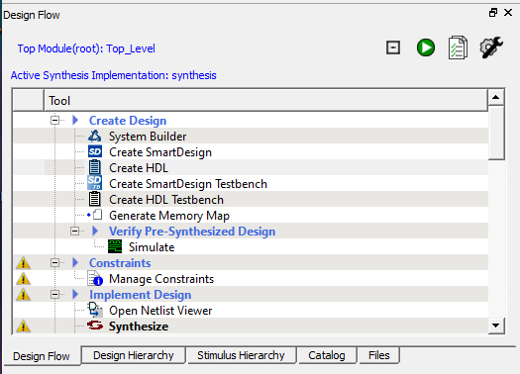
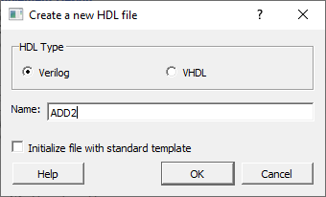
Step 1: Create New HDL File
NOTE: We are using the existing FPGA projects from Future Electronics: https://github.com/Future-Electronics-Design-Center/Creative-Eval-Board
Unzip the project located IGL2_MiV_FreeRTOS_Demo > FPGA Design
Open Libero SoC v12.0 or higher and open the project that was unzipped
Create a new HDL file by going to Design Flow > Create HDL
Select Verilog for HDL Type and give the file a name.
Click OK.
Fig. 1. Design Flow window to create a new HDL file
Fig. 2. Create a new HDL file

Slide 3
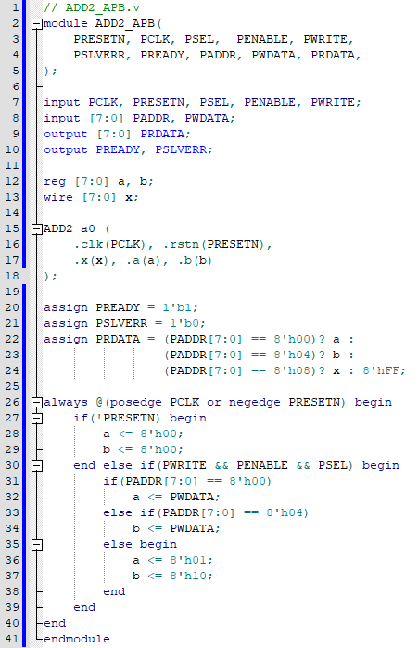
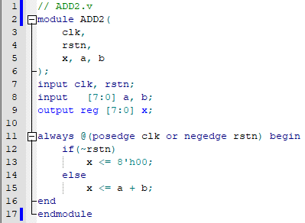
Step 2: Verilog Code
Enter the Verilog code to add two 8-bit numbers
Click on Check HDL File button for ADD2.v
Repeat 3-5 in Step 1 and name the file ADD2_APB
Enter the Verilog code of APB wrapper for ADD2 module
Click on Check HDL File button for ADD2_APB.v
Fig. 3. ADD2 Verilog code
Fig. 4. APB wrapper for ADD2

Slide 4
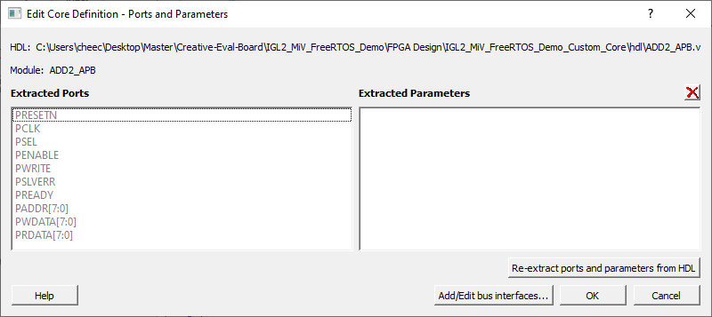
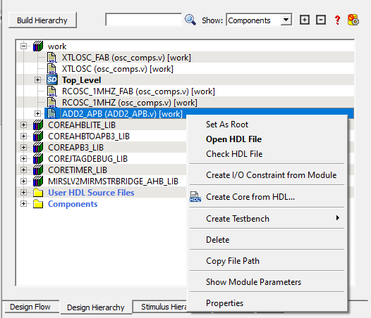
Step 3: Create Core From HDL With Bus Interface
Select Design Hierarchy
Click on Build Hierarchy for the Verilog HDL file to appear
Right-click the HDL file and select Create Core form HDL
Click Yes to add bus interface to the core
Click on Add/Edit bus interfaces
Fig. 6. Edit Core Definition to add APB interface
Fig. 5. Design Hierarchy window to create core from HDL

Slide 5
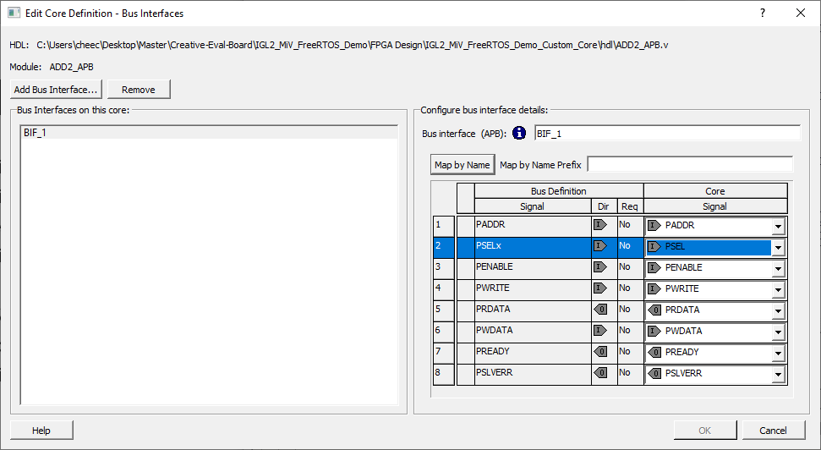
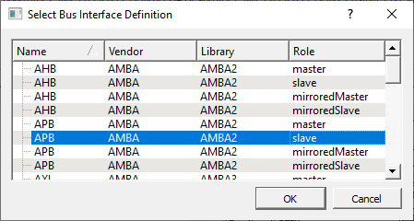
Step 4: Add APB Bus Interface
Click on Add Bus Interface
Select APB slave and then Click OK
In Configure bus interface details, choose PSEL in drop down menu. Other signals should be automatically assigned.
Click OK
Fig. 7. Edit Core Definition with APB signals
Fig. 8. Select APB bus interface for slave device

Slide 6
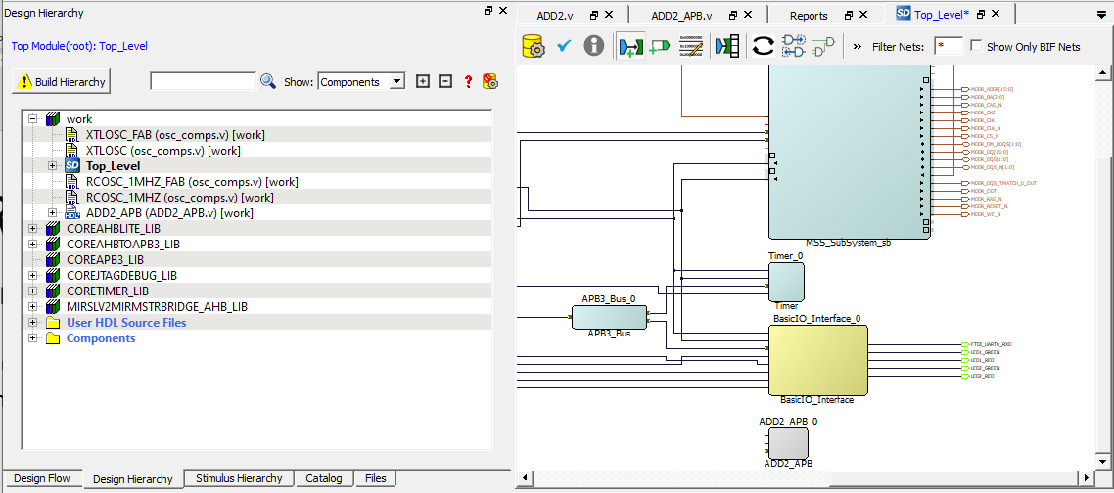
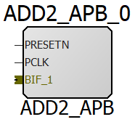
Step 5: ADD2 Core in SmartDesign
In Design Hierarchy, the ADD2_APB HDL file should be slightly difference (larger “HDL+” with blue background)
If not, then click on Build Hierarchy
Drag and drop the component into the SmartDesign
Fig. 10. Instantiated ADD2_APB core and its signals
Fig. 9. Adding ADD2_APB core to SmartDesign

Slide 7
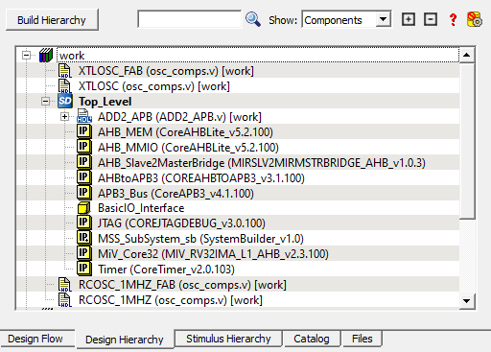
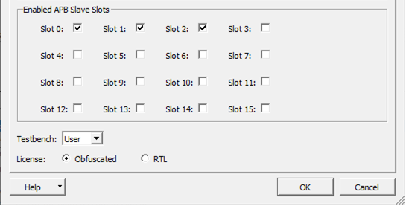
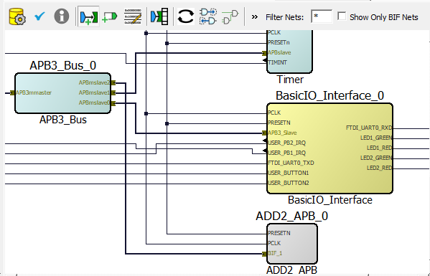
Step 6: Connecting Custom Core to Design
Enable slave slot in APB3_BUS_0
Double click APB3_BUS_0
Enable another slave slot
Click OK
Right-clicking the core and selecting Update Component
Connect the ADD2_APB _0 core to the design shown in Fig. 12
Click on Design Rules Check
Click on Generate Component
Click on Build Hierarchy
ADD2_APB should be listed under Top_Level SmartDesign
Fig. 11. Adding new APB slave slot
Fig. 13. ADD2_APB under SmartDesgin
Fig. 12. Connections of ADD2_APB_0 core to APB3_BUS_0

Slide 8
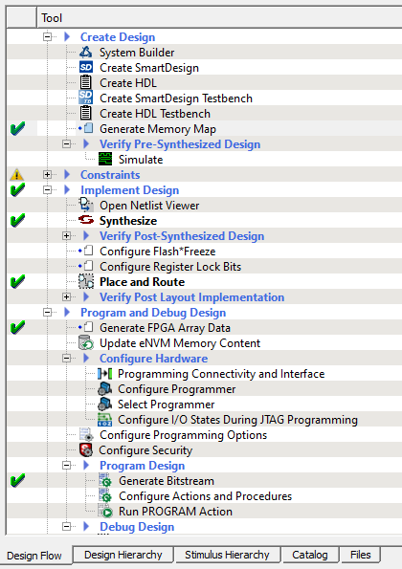
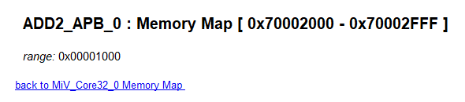
Step 7: Program The FPGA Board
In Design Flow, double-click on Synthesize
If no errors, green check mark appears
Double-click on Generate Bitstream
If no errors, green check mark appears
If there are no errors, connect the board to your computer
Then, click on Run PRGRAM Action
Before we program the board in C, click on Generate Memory Map
Take note of the address at the bottom of the data sheet for ADD2_APB_0
Fig. 14. Design Flow
Fig. 15. Memory address for ADD2_APB_0 core

Slide 9
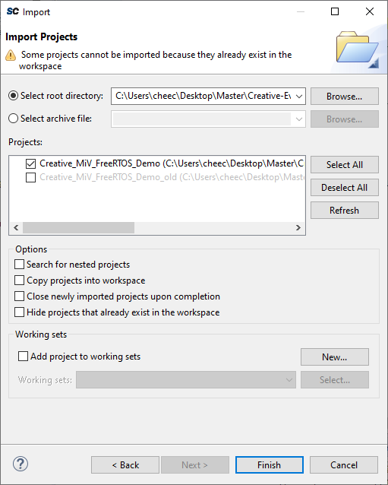
Step 8: Import Project in SoftConsole
Unzip the project located IGL2_MiV_FreeRTOS_Demo > Software Project
Open SoftConsole and select your workspace
Import software project into workspace
Go to File > Import > Exiting Projects into Workspace
Click Next
Click Browse and select unzipped folder Creative_MiV_FreeRTOS_Demo
Check the box for the correct project in Projects (Optional: Copy projects into workspace)
Click Finish
Fig. 16. Importing existing project to workspace

Slide 10
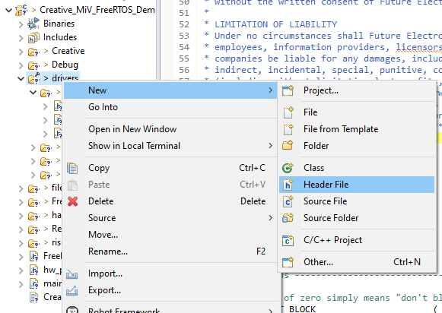
Step 9: Create Drivers for ADD2
Right-click drivers folder and add a new folder named ADD2
Add 3 new files to ADD2 folder:
Header File: ADD2.h
Header File: ADD2_regs.h
Source File: ADD2.c
Add the code in Appendix A, B, C to the respective files.
You can download the source files here.
Modify AND2_GATE_BASE_ADDR in ADD2.h to the one found in Step 7 #5
Fig. 17. Adding new folder and source files

Slide 11
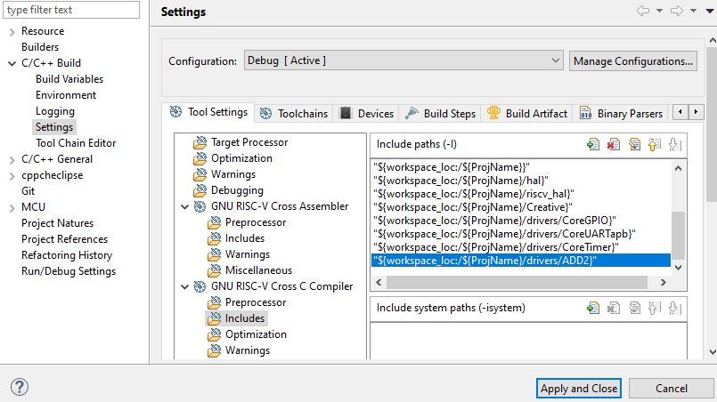
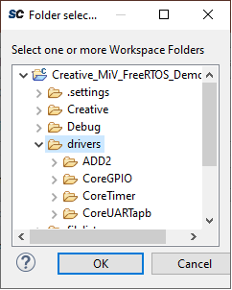
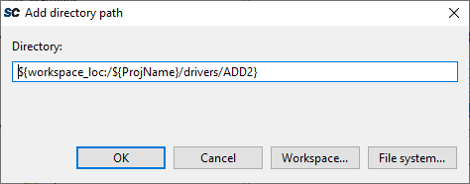
Step 10: Include ADD2 drivers
Right-Click the project and select Properties
Select C/C++ Build
In Tool Settings tab go to GNU RISC-V Cross C Compiler
Select Includes
In Include paths (-l), click on add button
Click on Workspace button
Find ADD2 folder and Click OK
Click OK
Click Apply and Close
Fig. 18. Adding ADD2 drivers to Includes
Fig. 19. Add directory path for Includes
Fig. 20. Selecting ADD2 folder

Slide 12
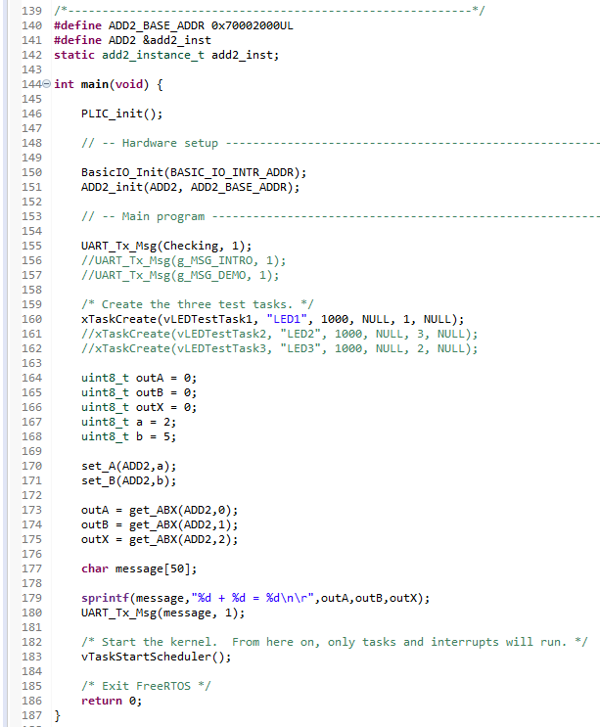
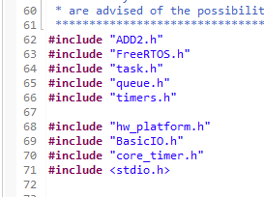
Step 11: ModiFy Main.C
In main.c, add the code in the red boxes
You can comment out unnecessary code
You can change the intro message. In this case, it is modified to “Checking…”
You can also place the code for ADD2 into a new task
Here is the source code for the modified main.c
Select the project and build
Fig. 21. Including header files in main.c
Fig. 22. Modified main.c to use ADD2 core

Slide 13
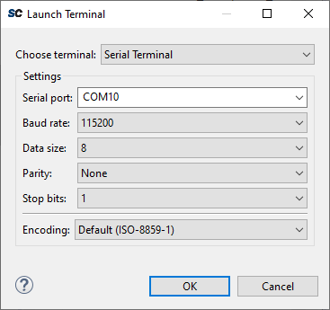
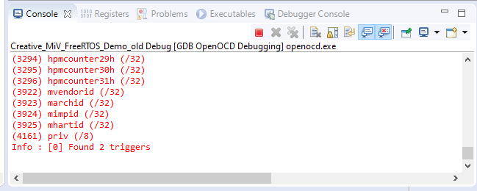
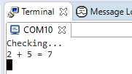
Step 12: Debug Project
Open a terminal from Windows > Show View > Terminals
Click Open a Terminal, select correct serial port, and click OK
Select the project and go to Run > Debug Configurations
In Main tab, confirm C/C++ Applications is using correct .elf file
In Debugger tab, add to
Config Options
--command "set DEVICE M2GL025“
--file board/microsemi-riscv.cfg
Commands
set $target_riscv = 1
set mem inaccessible-by-default off
set arch riscv:rv32
In Startup tab, uncheck Enable ARM semihosting and Pre-run/Restart reset
Click Apply and then Debug
After it finishes loading, click on Resume (F8)
Message will be displayed on terminal window
Fig. 23. Open a new terminal
Fig. 24. Console window after successful debugging
Fig. 25. Message in terminal
to add a = 2 and b = 5

Slide 14
Appendix A: ADD2.h
#ifndef DRIVERS_ADD2_ADD2_H_
#define DRIVERS_ADD2_ADD2_H_
#include <stdint.h>
#include "cpu_types.h"
#define ADD2_BASE_ADDR 0x70002000UL
typedef struct add2_instance add2_instance_t;
struct add2_instance {
addr_t base_addr;
};
void ADD2_init (
add2_instance_t * this_add2,
addr_t base_addr
);
void set_A (
add2_instance_t * this_add2,
uint8_t aValue
);
void set_B (
add2_instance_t * this_add2,
uint8_t bValue
);
uint8_t get_ABX (
add2_instance_t * this_add2,
uint8_t value
);
#endif /* DRIVERS_ADD2_ADD2_H_ */

Slide 15
Appendix B: ADD2_regs.h
#ifndef DRIVERS_ADD2_ADD2_REGS_H_
#define DRIVERS_ADD2_ADD2_REGS_H_
/* Register Addresses */
#define A_REG_OFFSET 0x00
#define B_REG_OFFSET 0x04
#define X_REG_OFFSET 0x08
#endif /* DRIVERS_ADD2_ADD2_REGS_H_ */

Slide 16
Appendix C: ADD2.c
#include "ADD2.h"
#include "ADD2_regs.h"
#include "../../hal/hal.h"
#include "../../hal/hal_assert.h"
void ADD2_init (
add2_instance_t * this_add2,
addr_t base_addr
) {
this_add2->base_addr = base_addr;
// clear all
HAL_set_8bit_reg(this_add2->base_addr, A, 0x00);
HAL_set_8bit_reg(this_add2->base_addr, B, 0x00);
}
void set_A (
add2_instance_t * this_add2,
uint8_t aValue
) {
HAL_set_8bit_reg(this_add2->base_addr, A, aValue);
HAL_ASSERT( set_AB( this_add2 ) == aValue );
}
void set_B (
add2_instance_t * this_add2,
uint8_t bValue
) {
HAL_set_8bit_reg(this_add2->base_addr, B, bValue);
HAL_ASSERT( set_AB( this_add2 ) == bValue );
}
uint8_t get_ABX (
add2_instance_t * this_add2,
uint8_t value
) {
uint8_t output = 0;
if(value == 0)
output = HAL_get_8bit_reg(this_add2->base_addr, A);
else if(value == 1)
output = HAL_get_8bit_reg(this_add2->base_addr, B);
else if(value == 2)
output = HAL_get_8bit_reg(this_add2->base_addr, X);
else
HAL_ASSERT(0);
return output;
}

Slide 17
Thank You!

